Slide 1
Text Analysis

Slide 3
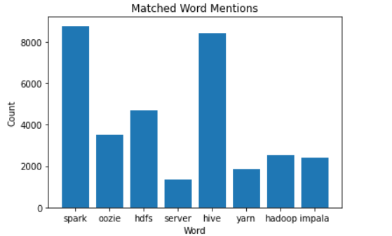
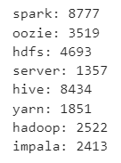

For Particular Service Number of INCs Received

Slide 4
To find service wise INC resolution provider
import pandas as pd import matplotlib.pyplot as plt def plot_resolved_incidents(data): resolved_counts = data[data['Status'] == 'Resolved']['SolvedBy'].value_counts() resolved_counts.plot(kind='bar') plt.xlabel('User') plt.ylabel('Number of Incidents Resolved') plt.title('Number of Incidents Resolved by Each User') plt.show() # Read CSV file data = pd.read_csv('Output_file_random_data_generator.csv') # Call the function to plot the graph plot_resolved_incidents(data)

Slide 5
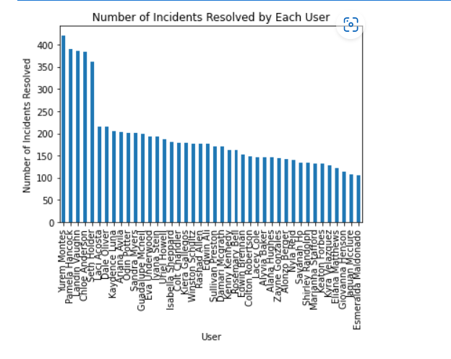


Slide 6
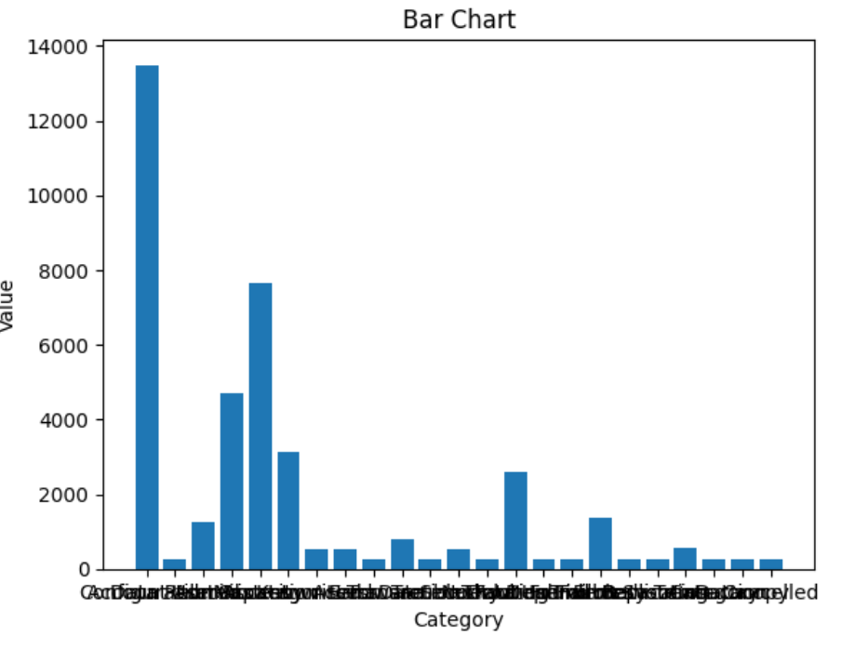

Category wise INC resolve

Slide 7
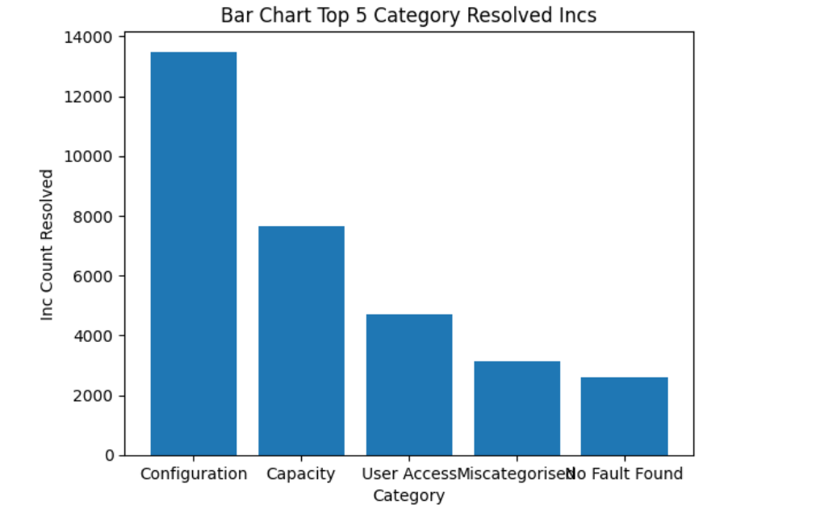
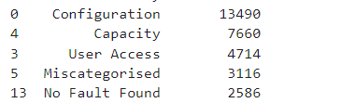
Category wise INC resolve Top 5

Slide 8
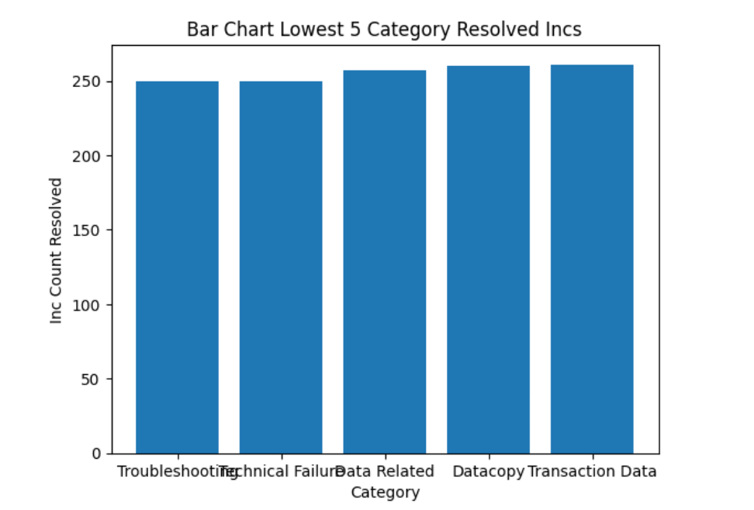

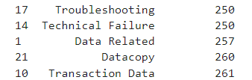
Category wise INC resolve Bottom 5

Slide 9
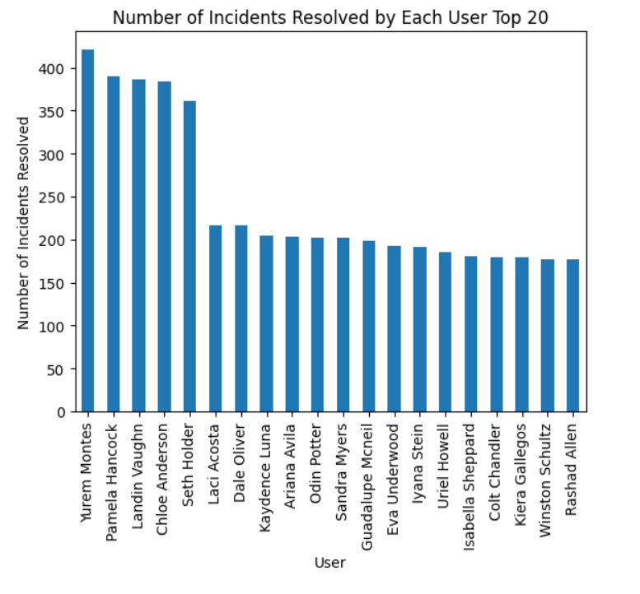
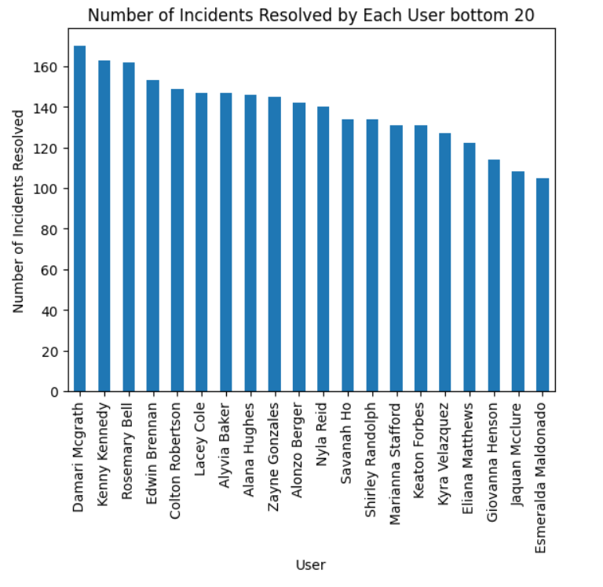


User wise INC resolve Top 20 and Bottom 20

Slide 10


Add lable

Slide 11
- category wise max resolver
Service wise max resolver
Categoty wise service resolve

